Slide 1
OCI Networking Gateways

Slide 2

Internet Gateway
ORACLE CLOUD DATA CENTER REGION
Internet gateway provides a path for network traffic between your VCN and the internet
Availability Domain – AD1
Internet
Instance with public IP
SUBNET A, 10.0.1.0/24
Internet Gateway
You can have only one internet gateway for a VCN
After creating an internet gateway, you must add a route for the gateway in the VCN's Route Table to enable traffic flow
Regional Public Subnet
VCN, 10.0.0.0/16

Slide 3

NAT Gateway
NAT gateway gives an entire private network access to the internet without assigning each host a public IP address
ORACLE CLOUD DATA CENTER REGION
Availability Domains – AD1
Internet
Destination CIDR | Route Target
0.0.0.0/0 | NAT Gateway
SUBNET A, 10.0.1.0/24
NAT Gateway
Instance with private IP
Hosts can initiate outbound connections to the internet and receive responses, but not receive inbound connections initiated from the internet. Use case: updates, patches)
You can have more than one NAT gateway on a VCN, though a given subnet can route traffic to only a single NAT gateway
Regional Private Subnet
VCN, 10.0.0.0/16

Slide 4
Service Gateway
ORACLE CLOUD DATA CENTER REGION
Service gateway lets resources in VCN access public OCI services, exposed on the Oracle Services Network, such as Object Storage, but without using either Internet or NAT gateway
Object Storage
AD1
Service Gateway
Any traffic from VCN that is destined for one of the supported OCI public services uses the instance's private IP address for routing, travels over OCI network fabric, and never traverses the internet. Use case: back up DB Systems in VCN to Object Storage)
SUBNET A, 10.0.1.0/24
Destination CIDR | Route Target
Service CIDR Label | Service Gateway
Regional Private Subnet
VCN, 10.0.0.0/16
Service CIDR labels represent all the public CIDRs for a given Oracle service or a group of Oracle services. E.g.
OCI <region> Object Storage
All <region> Services

Slide 5
Dynamic Routing Gateway
ORACLE CLOUD DATA CENTER REGION
A virtual router that provides a path for private traffic between your VCN and destinations other than the internet
You can use it to establish a connection with your on-premises network via IPsec VPN or FastConnect (private, dedicated connectivity)
After attaching a DRG, you must add a route for the DRG in the VCN's route table to enable traffic flow
DRG is a standalone object. You must attach it to a VCN. VCN and DRG have n:1 relationship
AD
Destination CIDR | Route Target
172.16.0.0/16 | DRG
SUBNET B, 10.0.2.0/24
VCN, 10.0.0.0/16
Regional Private Subnet
CUSTOMER DATA CENTER
Customer Premises Equipment (CPE)
Remote Private Network, 172.16.0.0/16

Slide 6
DRG Routing Engine
Design
Each VCN, FastConnect, IPSEC, or RPC connection is “connected” to the DRG via an Attachment.
Each “Attachment” has a route table assigned, which directs ingress traffic to a specific egress attachment.
Operation
A Packet arrives from VCN or on-premise into the DRG
The DRG routing engine determines which Attachment to egress the packet out of based on the associated route table.

Slide 7
DRG Enhancements: Remote On Ramp
FastConnect or IPSEC VPN in Region (A)
Able to access resources in Region (B)
Uses the OCI Private backbone.
Can also provide redundancy.

Slide 8
DRG : ECMP (Active/Active) support
OCI now support “ECMP” for Active/Active load sharing.
Bundle up to (8) IPSEC or FastConnect connections.
Enabled on a per-route table basis.

Slide 9
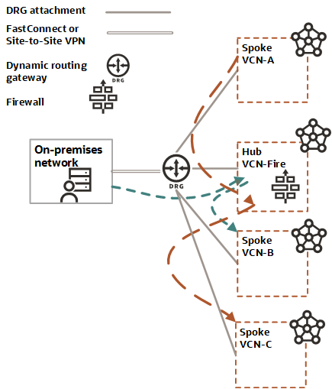
DRG: L3 Firewall
All traffic between VCNs is routed via L3 NVA (Network Virtual Appliance – or Firewall)
Routing tables are used to direct traffic via a specific VCN, and the DRG-attachment routing table forces all traffic to the NVA.

Slide 10
Thank you

